Slide 1


JavaScript
Sipan Sahakyan

Slide 2
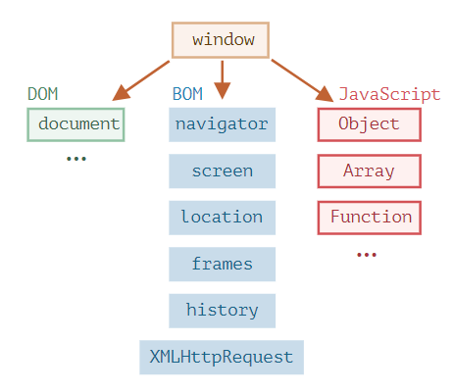
Browser environment

Slide 3
DOM (Document Object Model)
DOM for short, represents all page content as objects that can be modified.
The document object is the main “entry point” to the page
// change the background color to red
document.body.style.background = "red";

Slide 4
BOM (Browser Object Model)
(BOM) represents additional objects provided by the browser (host environment) for working with everything except the document.
The navigator object provides background information about the browser and the operating system. - navigator.userAgent – about the current browser - navigator.platform – about the platform
The location object allows us to read the current URL and can redirect the browser to a new one.
alert(location.href); // shows current URL
if (confirm("Go to Wikipedia?")) {
location.href = "https://wikipedia.org"; // redirect the browser to another URL
}
Notes:
Property names limitations

Slide 5
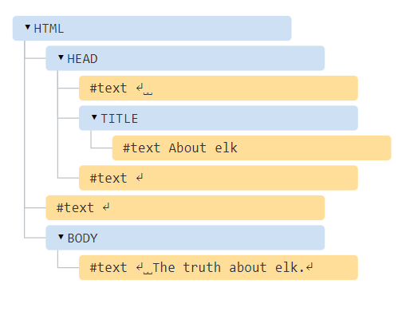
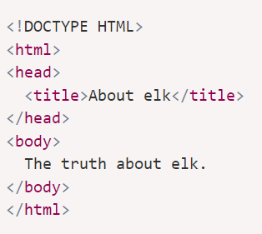
Dom Tree

Slide 6
Node
Every tree node is an object.
Tags are element nodes (or just elements) and form the tree structure: <html> is at the root, then <head> and <body> are its children, etc.
The text inside elements forms text nodes, labelled as #text. A text node contains only a string. It may not have children and is always a leaf of the tree.
Special characters in text nodes:
a newline: ↵ (in JavaScript known as \n)
a space: ␣

Slide 7
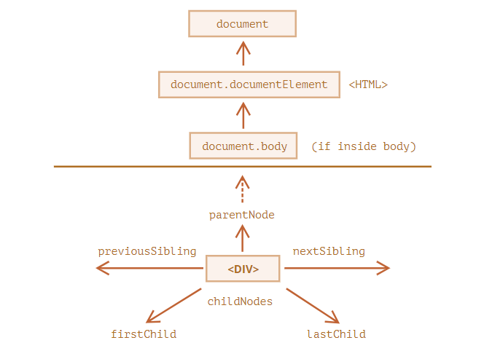
Walking the DOM
All operations on the DOM start with the document object.

Slide 8
Children: childNodes, firstChild, lastChild
Child nodes (or children) – elements that are direct children. In other words, they are nested exactly in the given one. For instance, <head> and <body> are children of <html> element.
Descendants – all elements that are nested in the given one, including children, their children and so on.
<script>
for (let i = 0; i < document.body.childNodes.length; i++) {
alert( document.body.childNodes[i] ); // Text, DIV, Text, UL, ..., SCRIPT
}
</script>

Slide 9
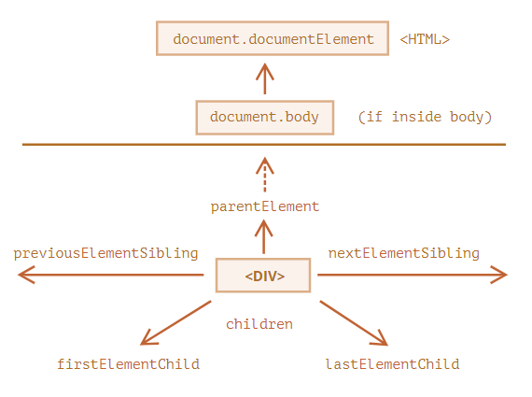
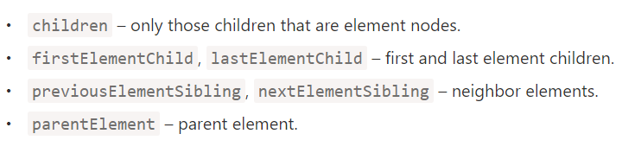
Siblings and the parent

Slide 10
Searching: getElement*, querySelector*
let elem = document.getElementById('elem');
let divs = document.getElementsByTagName('div');
let chapter = document.querySelector('.chapter');

Slide 11
Introduction to browser events
An event is a signal that something has happened.
Mouse events:
click – when the mouse clicks on an element (touchscreen devices generate it on a tap).
contextmenu – when the mouse right-clicks on an element.
mouseover / mouseout – when the mouse cursor comes over / leaves an element.
mousedown / mouseup – when the mouse button is pressed / released over an element.
mousemove – when the mouse is moved.

Slide 12
Keyboard events:
keydown and keyup – when a keyboard key is pressed and released.
Form element events:
submit – when the visitor submits a <form>.
focus – when the visitor focuses on an element, e.g. on an <input>.
Document events:
DOMContentLoaded – when the HTML is loaded and processed, DOM is fully built.
CSS events:
transitionend – when a CSS-animation finishes.

Slide 13
Event handlers
HTML-attribute
<input value="Click me" onclick="alert('Click!')" type="button“>
DOM property elem.onclick = function() {
alert('Thank you');
};

Slide 14
addEventListener
element.addEventListener(event, handler, [options]);
event Event name, e.g. "click".
handler handler function
options
once: if true, then the listener is automatically removed after it triggers.
capture: the phase where to handle the event, to be covered later in the chapter Bubbling and capturing. For historical reasons, options can also be false/true, that’s the same as {capture: false/true}.
passive: if true, then the handler will not call preventDefault()

